Slide 1



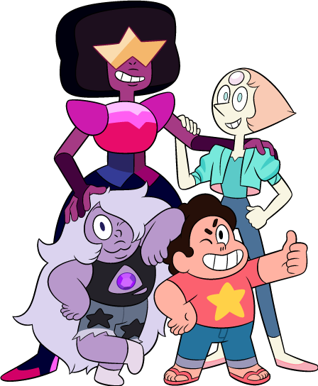
Digital Lesson #2
Tool to Build Up Body Confidence
Notes:
Video Note:
If a Security Warning about external media appears, click Enable Content. This will allow the videos to play.

Slide 2
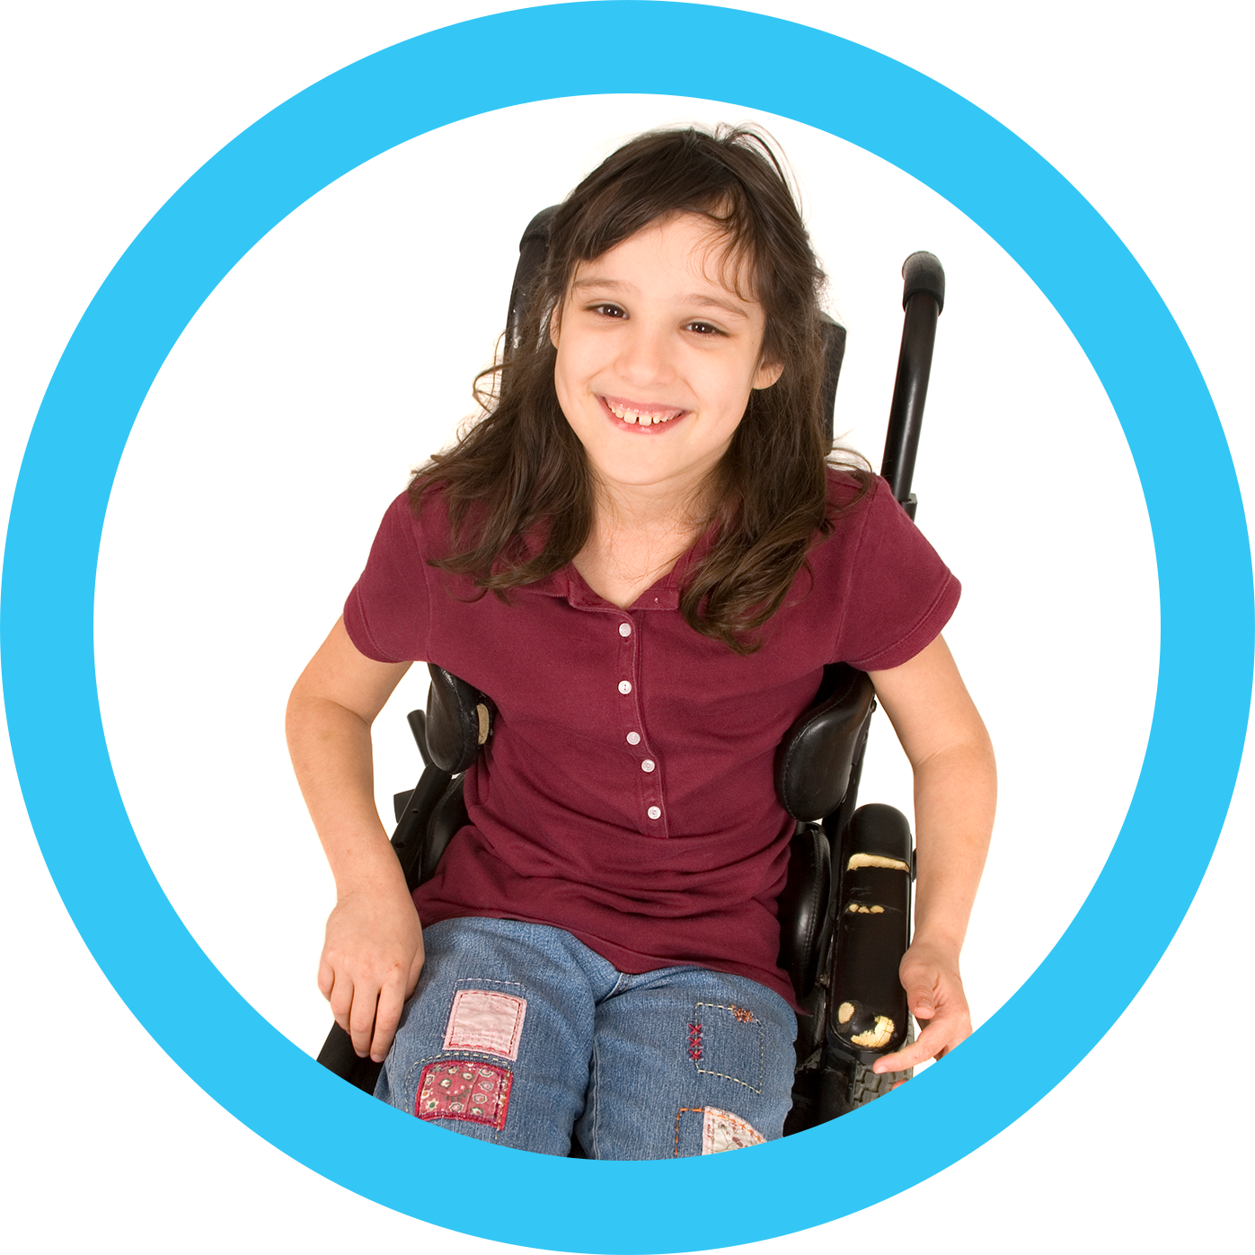
We are going to talk about our bodies.
How do we create a safe, respectful, and kind space?
Session 1
Today…
Notes:
Teacher Notes:
Virtual Facilitation Options:
Engage pupils in establishing ‘ground rules’ for discussion by asking them, ‘how do we create a safe, respectful and kind environment for conversations about our bodies?’ Examples might include: listen respectfully, no interrupting, question ideas without criticising people, no insults, give everyone a chance to speak, etc.
Write responses on the board and keep them there through the duration of the series.
Teacher Note: If your class has already completed the Confronting Comparisons to Build Body Confidence digital lesson bundle, you may review the norms that you created for those lessons.
When needed, refer to the ground rules as a reminder of how important it is to respect one another in these sensitive conversations.

Slide 3
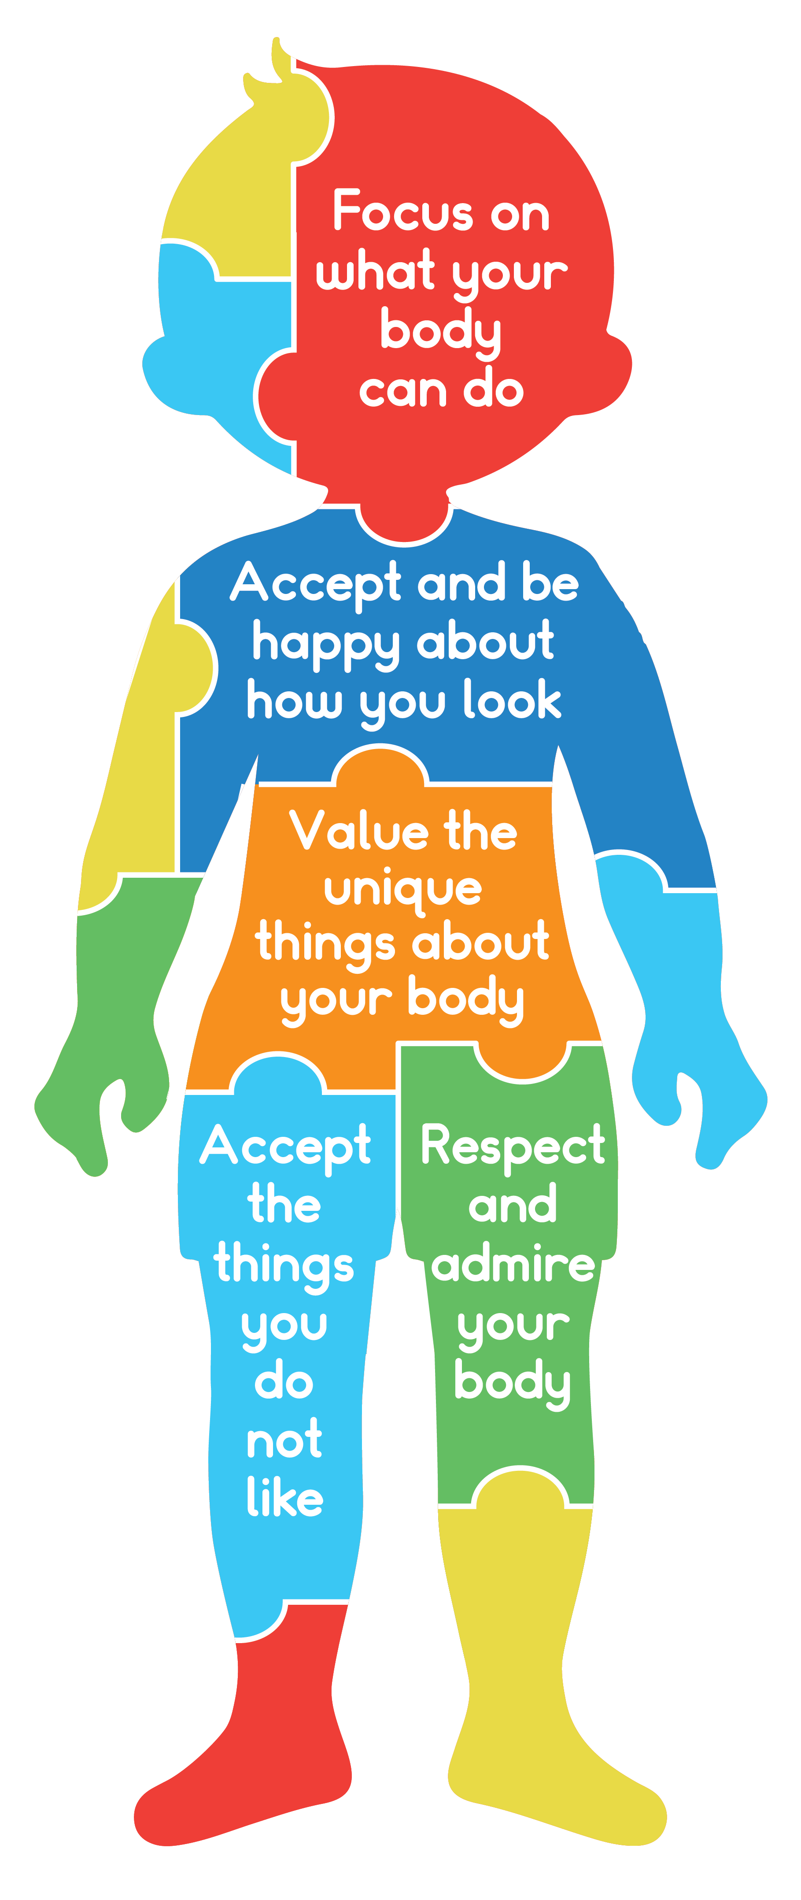

Body Confidence
Session 1
Body Confidence: how a person feels about the way
they look.
Notes:
Teacher Notes:
Introduce or review the concept of body confidence or the sense of love and respect for our body and what it can do.
Use the image to discuss what body confidence looks like.
Wood-Barcalow, et al., 2010; Tylka & Wood-Barcalow, 2015

Slide 4
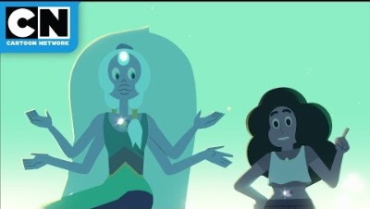
Body Functionality
Session 1
Notes:
Video Note:
If a Security Warning about external media appears, click Enable Content. This will allow the videos to play.
Teacher Notes:
Explain that one way to increase respect and love for your body is to focus on body function, or what their bodies can do, instead of how their bodies look.
Click to show the video Body Functionality.
After viewing the video, consider asking one or more of the following questions:
What are some human ‘powers’ mentioned in the video?
(Anticipated responses might include: humans have the power to grow, to eat, to sleep, to heal, to care for themselves and others, etc.)
What are some other ‘powers’ that are unique to humans –things that humans can do that other animals cannot do?
(Anticipated responses might include: humans have the power to think, to speak a language, to create things, care for other animals, etc.)
What are some unique ‘powers’ that your body can do?
(Anticipated responses might include: unique skills and abilities, ability to help others when they are sad or hurt, ability to be kind to others, ability to make others laugh or feel good, etc.)

Slide 5
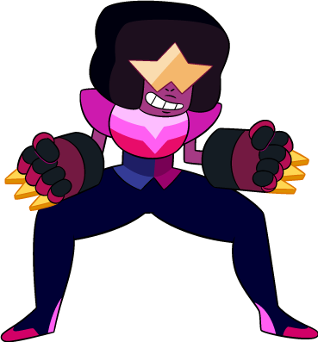
Bodies Can Do A Lot
Session 1
What can the
HUMAN BODY
do?
What can
MY BODY
do?
Notes:
Teacher Notes:
Reinforce that focusing on function instead of appearance can increase body confidence and assist us in appreciating our bodies.
Distribute one Body Function handout from the What’s Your Function activity sheet to each pupil.
As a group, brainstorm a list of things the human body can do. Record answers on the board as students write them on their handouts. Anticipated responses include things like:
Breath
Convert food into energy
Produce warmth
See, smell, hear, feel
Heal broken bones
Fight illness
Challenge each child to now write a list of all the special things that his/her body can do. Encourage pupils to think of skills or traits that make them unique. Anticipated responses might include things like:
I can play [sport] well
I can play the piano
My voice lets me sing in the choir
I give good hugs

Slide 6
Flip the Script
Session 1
I feel too skinny.
My tummy is big,
I ate too much.
I don’t like the colour
of my skin.
I feel fat.
My arms are weak.
Notes:
Teacher Notes:
Define body talk: Body talk is conversation about body shape, weight, or size.
Remind pupils that body talk, even if it seems positive, can have negative effects on body confidence. This is because the focus is on a person’s appearance instead of their abilities/function.
In the following statements, have the class practice converting negative body talk statements into positive statements about function. There are suggested responses provided for each statement below and in the facilitation guide.
Click to reveal the first example of body talk: ‘I feel fat’. Ask pupils to reframe the body talk to positive statements about body function.
(Anticipated responses might include: ‘I appreciate that my body keeps going even when I am tired’; ‘I appreciate all the things my body lets me enjoy’; etc.)
Click again to reveal the next example: ‘I don’t like the colour of my skin’. Ask pupils to reframe the negative body talk to positive statements about body function.
(Anticipated responses might include: ‘It is amazing how my skin stretches and grows with my body’; ‘My colour of skin is a combination of my mum’s and dad’s skin colours’; etc.)
Click to reveal the next example: ‘My arms are weak’. Ask pupils to reframe the negative body talk to positive statements about body function.
(Anticipated responses might include: ‘It is amazing that my arms allow me to play video games’; ‘My arms let me give warm hugs to my family’; etc.)
Click to reveal the next example: ‘I feel too skinny’. Ask pupils to reframe the negative body talk to positive statements about body function.
(Anticipated responses might include: ‘My body is growing and will change and evolve with puberty’; ‘It is amazing that my body lets me play (chess, sports, games, etc.)’; etc.)
Click to reveal the next example: ‘My tummy is big, I ate too much’. Challenge students to reframe the negative body talk to positive statements about body function.
(Anticipated responses might include: ‘It is amazing how my body converts food to fuel’; ‘it is interesting to see the small changes in my body throughout the day’.

Slide 7

What are some things you can say, think, or do to be more confident?
Session 1
Reflect
Notes:
Teacher Notes:
Reflect with the class diverse ways to increase and maintain body confidence. What are some things they can say, think, or do to be more confident?

Slide 8
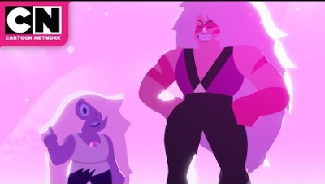
Teasing and Bullying
Session 2
Notes:
Video Note:
If a Security Warning about external media appears, click Enable Content. This will allow the videos to play.
Teacher Notes:
Tell pupils that one thing that can damage their body confidence is teasing and bullying.
Click to show the video Teasing and Bullying.
Lead a discussion using the following as a guide:
Have you ever been teased because of the way you look?
Have you ever teased someone else because of the way they look?
Why do you think people tease others?

Slide 9
What’s the Difference?
Session 2
TEASING | BULLYING
Making fun of someone | Being mean to someone on purpose, over and over again
Notes:
teacher Notes:
Explain to pupils that there is a difference between teasing and bullying.
TEASING: making fun of someone; can lead to similar outcomes as bullying
BULLYING: repeated, unwanted, and aggressive behavior that includes a real or perceived power imbalance
Remind pupils that not all teasing is bad, but when it is done over and over again or is meant to hurt someone, it can become bullying.

Slide 10
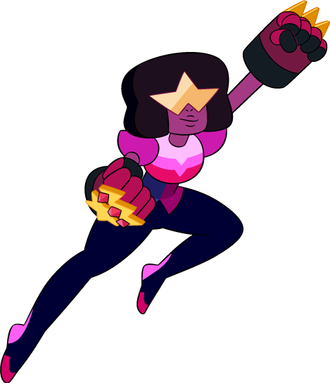
Bullying and Teasing Related to Weight
Session 2
Bullying and teasing related to weight: when a child teases or hurts another child because of how they look or their weight.
Victims are more likely to:
  Feel sad or nervous a lot
  Dislike how they look
  Have low self-esteem
Notes:
Teacher Notes:
Victims of bullying and teasing related to weight are more likely to:
Feel sad or nervous a lot
Dislike how they look
Have low self-esteem
https://www.stopbullying.gov/blog/2018/11/05/preventing-weight-based-bullying.html

Slide 11
School’s Anti-Bullying Policy
Session 2
PLUS | MINUS | INTERESTING
What do you like? | How can it be better? | What are some things you found interesting?
Example: You are helping someone when you report it. | Example: More examples of bullying. | Example: The whole school is doing it.
Type here… | Type here… | Type here…
Notes:
Teacher Notes:
Tell pupils that sometimes bullying, and teasing are obvious, but sometimes they are less clear. Bullying and teasing might look and feel different to different people. Explain that this kind of behaviour often happens in schools.
Show pupils the school’s anti-bullying policy and procedures for handling bullying. Read through with pupils, stopping to clarify when needed. Provide approximately 5–10 minutes for pupils to analyse with a partner what they think is positive about the policy and what they think might be missing. Ask for 3–4 volunteers to offer their ideas for each column of the Plus, Minus, Interesting chart. Record ideas on the slide.

Slide 12
What can we do to stop bullying?
Session 2
Type ideas here…
Notes:
Teacher Notes:
Ask pupils to brainstorm ways to prevent bullying and teasing related to weight and support peers if they feel they are being bullied or teased.
Guide pupils through the process of creating a 'Classroom Anti-Bullying Policy' that reflects the ideas they produced for the Plus, Minus, Interesting chart. Record pupils’ responses as they brainstorm their ideas on the slide.
Discuss how pupils in the class how they will help each other to keep to the 'Classroom Anti-Bullying Policy' (e.g., What will this look like? How will we know this is working? Who can we rely on to keep us on track?)

Slide 13
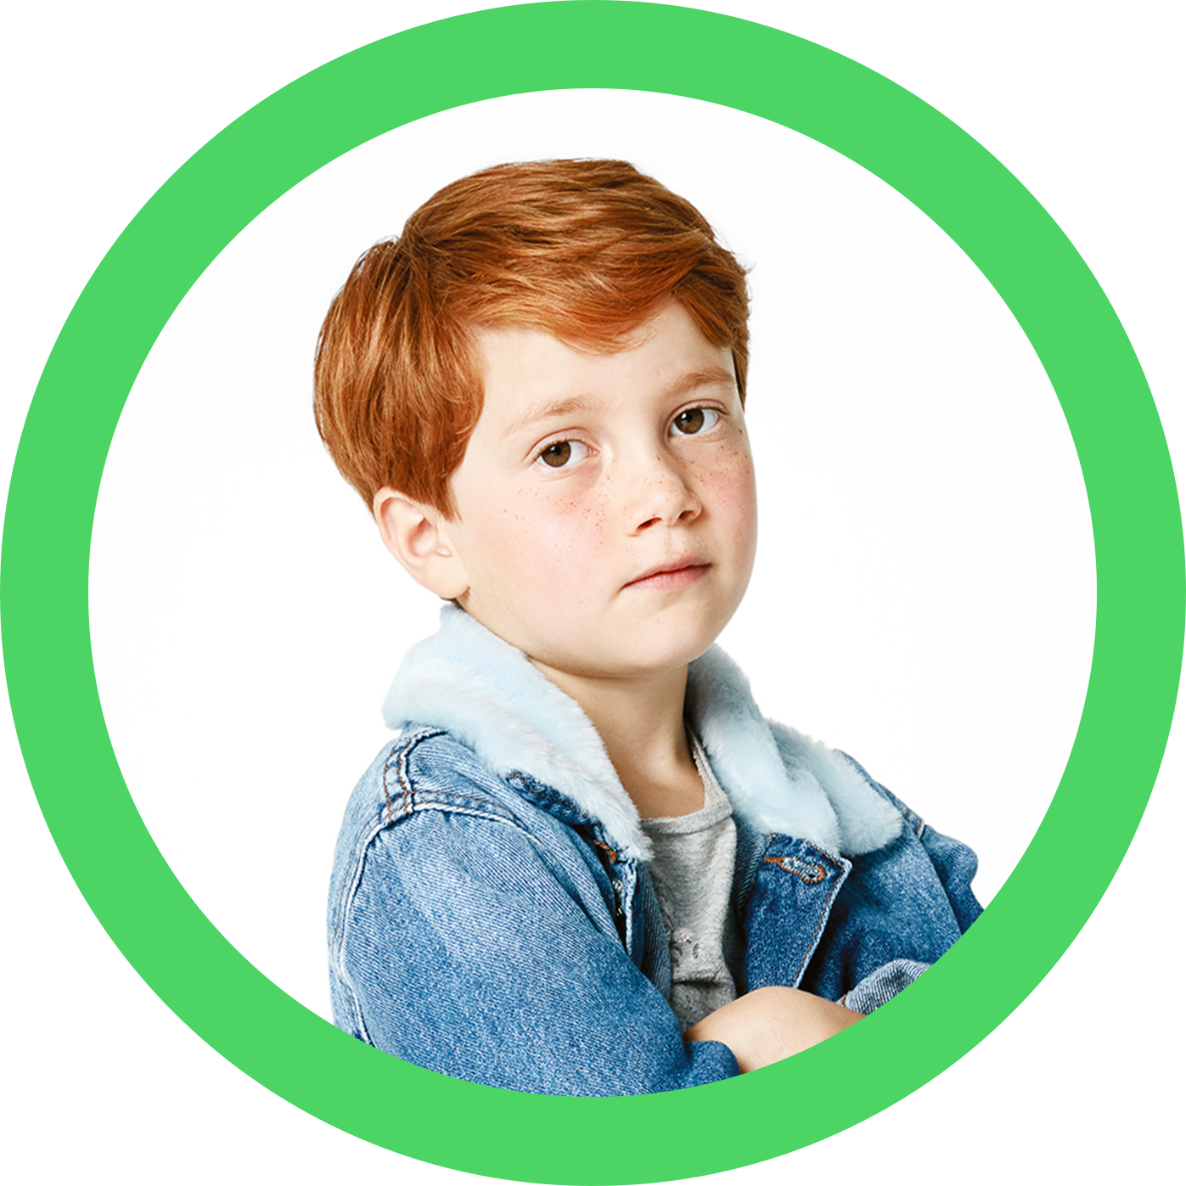
Review
Session 3
What does it mean to be bullied?
What does it mean to bully someone else?
What can you do if you are being bullied?
What can you do if you see someone being bullied?
Notes:
Teacher Notes:
Begin the lesson by reinforcing what pupils learned about bullying and teasing related to
weight and the effects it has on body confidence.
Lead a brief discussion about the following questions, clicking one at a time, and record
pupils’ responses on the board, addressing misconceptions as they arise:
What does it mean to be bullied?
Click to reveal ‘What does it mean to bully someone else?’
Click to reveal ‘What can you do if you are being bullied?'
Click to reveal 'What can you do if you see someone being bullied?'
Teacher Note: If pupils do not mention what bullying is then reinforce that bullying is
unwanted, aggressive behavior that involves a real or perceived power imbalance.
Explain that today the class will identify and practice strategies they can use to address bullying.

Slide 14



Role Playing
Session 3
What did you do in this situation? Did it work?
Why or why not?
Do you think this would work in real life?
Why or why not?
What else can you do in this situation?
Let's say this happened to you. How confident do you feel that you could stop bullying?
Not Confident
Unsure
Confident
Notes:
Teacher Notes:
Virtual Facilitation Options:
Arrange pupils into groups of four. Give one Role Playing Scenario to each group, make sure you distribute the scenarios evenly.
Explain that each scenario features a different strategy that pupils can use when presented with bullying.
Give pupils approximately ten minutes to create and practice a role play based on their scenario. Invite groups one at a time to perform their role play for the class.
After each role play, facilitate a brief discussion. Click to use the following questions as a guide:
What did you do in this situation? Did it work? Why or why not?
Do you think this would work in real life? Why or why not?
What else can you do in this situation?
Let’s say this happened to you. How confident do you feel that you could stop bullying?
Ask the class to pick a strategy and try it the next time they see or experience bullying.

Slide 15
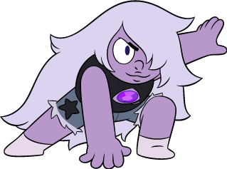
How to Stop Bullying & Teasing
Session 3
Strong 'NO' or 'STOP'
Walk away
Change the subject
Laugh it off
Stand up against the bully
Be friends with victims
Get help
Notes:
Teacher Notes:
Reveal the types of responses that can be used in each of the five scenarios.
Ask 3-4 volunteers to share which strategy they think they would be most likely to use in the future.

Slide 16

Let’s Review
Session 3
What is body confidence?
What is body functionality?
What strategies can we use to stop bullying and teasing?
Notes:
Teacher Notes:
Recap pupils’ learning so far by asking the following questions. Write their responses on the board, addressing any misconceptions as they arise.
What is body confidence?
What is body function?
What strategies can we use to stop bullying and teasing?
Invite pupils to discuss with a partner what he/she would change to stop bullying and teasing.

Slide 17
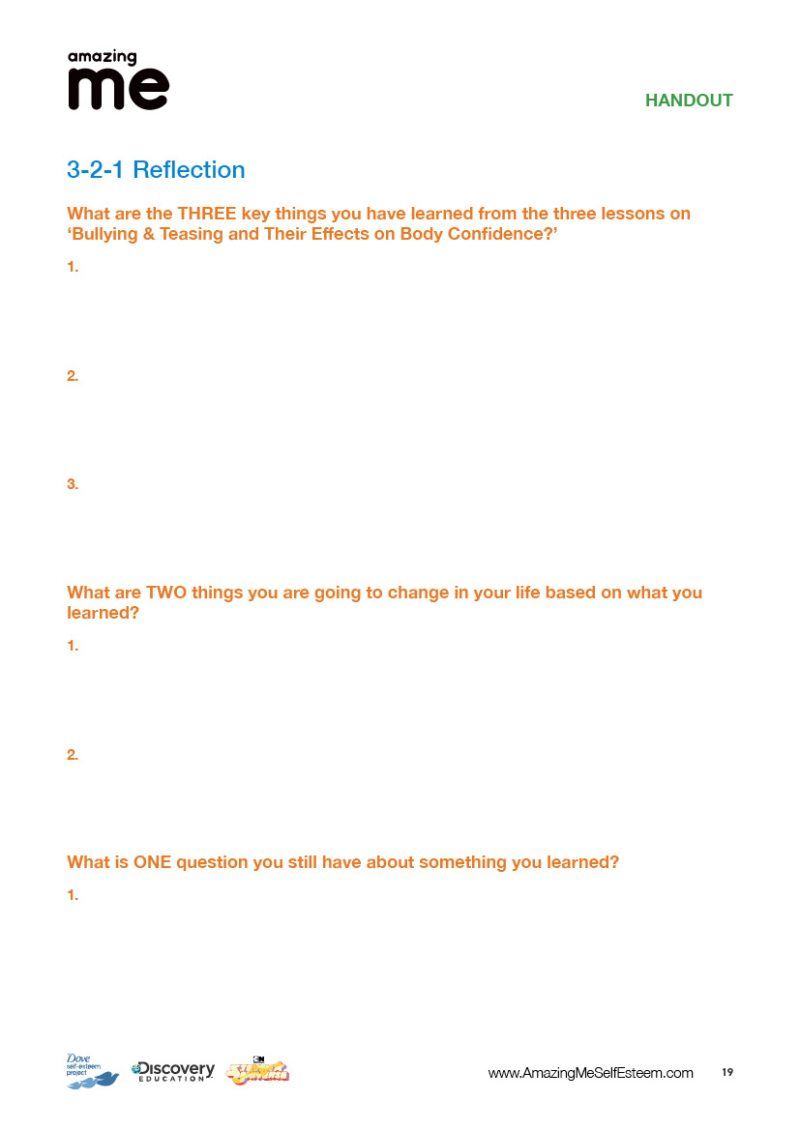
3-2-1
Session 3
Notes:
Teacher Notes:
Distribute one 3-2-1 Reflection handout to each pupil.
Collect reflection from pupils. If time allows, choose a few questions that remain and discuss with the group. If you are able, follow up with pupils regarding their reflection after the lessons.

Slide 18
Glossary
Body Confidence: how a person feels about the way they look.
Body Function: what the body can do; how well the body works.
Bullying and Teasing Related to Weight: when a child teases or hurts another child because of how they look or their weight.

